Slide 1
Machine Learning Tutorial
Basic introduction

Slide 2
Computer Version Nature Language Processing Robotic/Automatic Biology

Slide 3
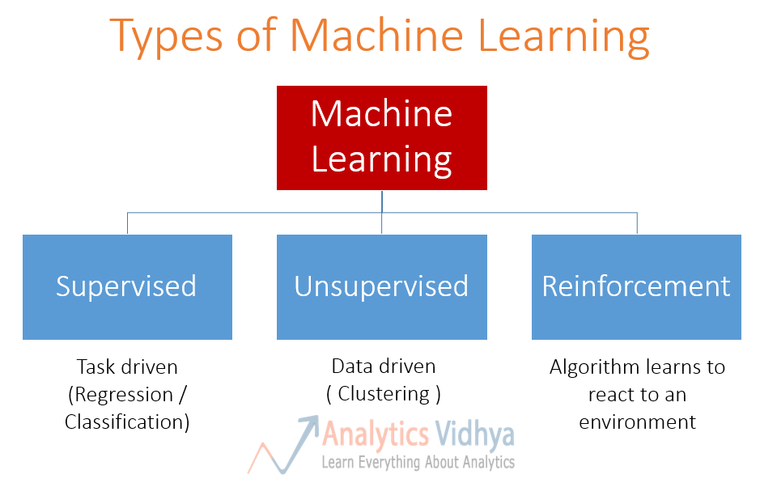
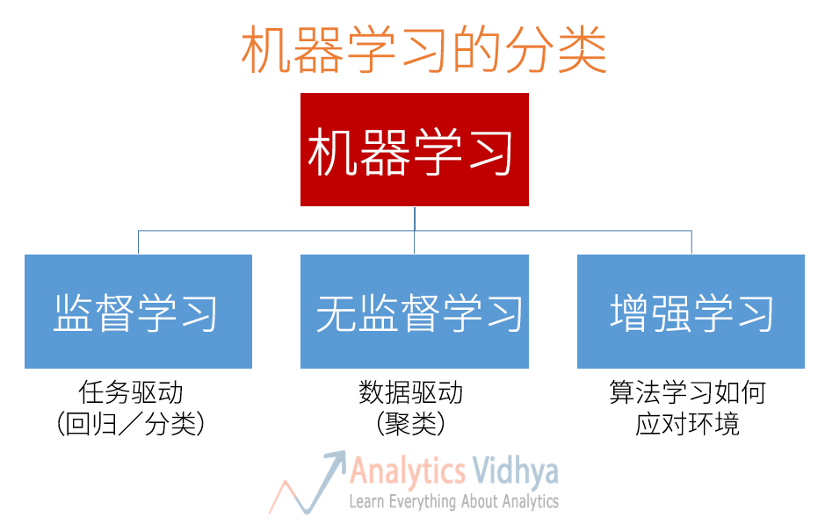

Slide 4
Basic Concept
Cross Validation
Over Fitting
Activation Function
Supervised Learning
UnSupervised Learning
Batch
Epoch
Layer
Train Set
Test Set
Feature
Dimensionality
Generalization
Maxpooling
L1 /L2
Benchmark
Baseline

Slide 5
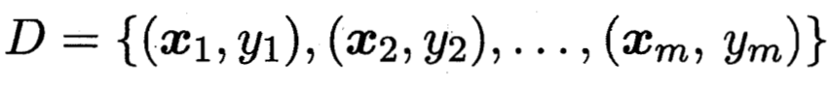
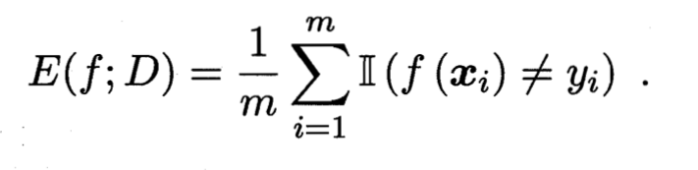
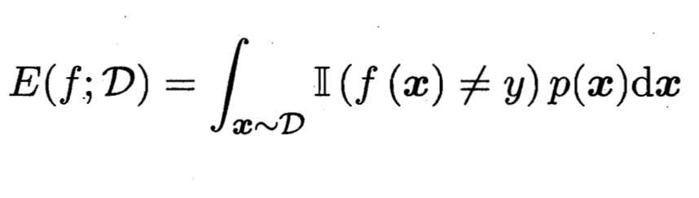
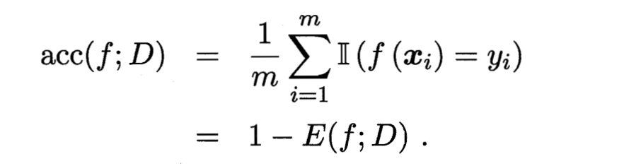
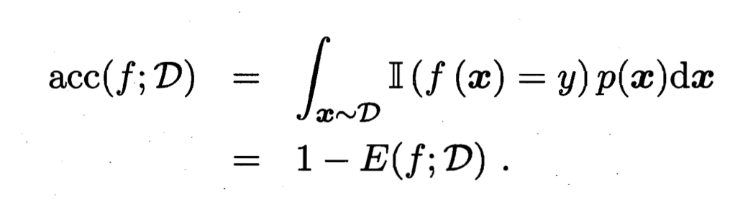
Basic Concept

Slide 6
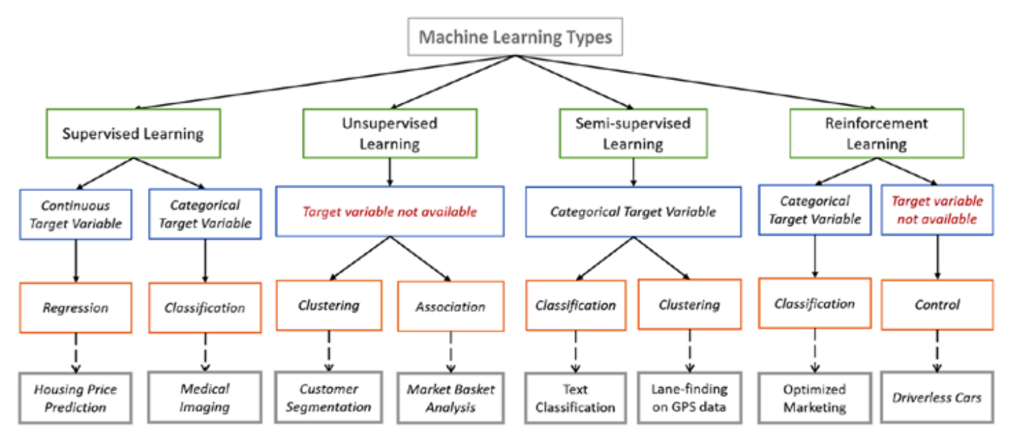
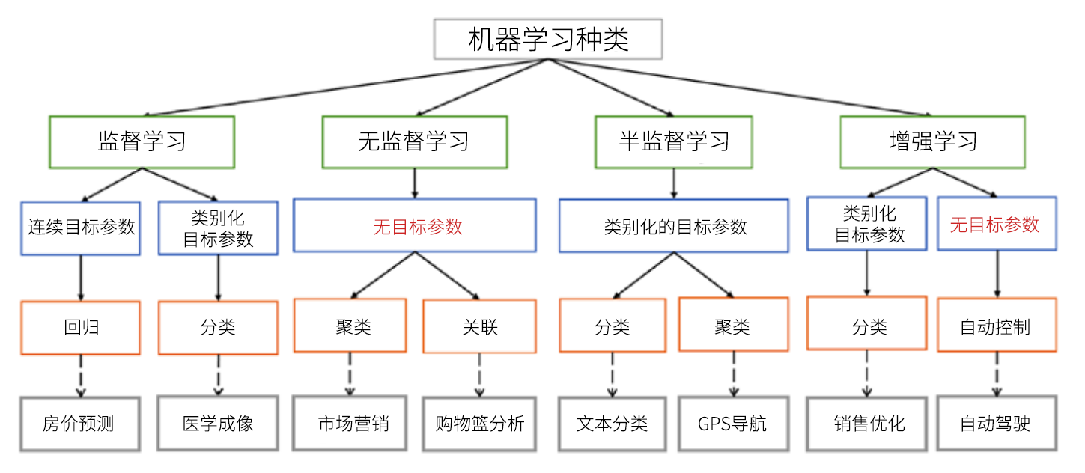

Slide 7
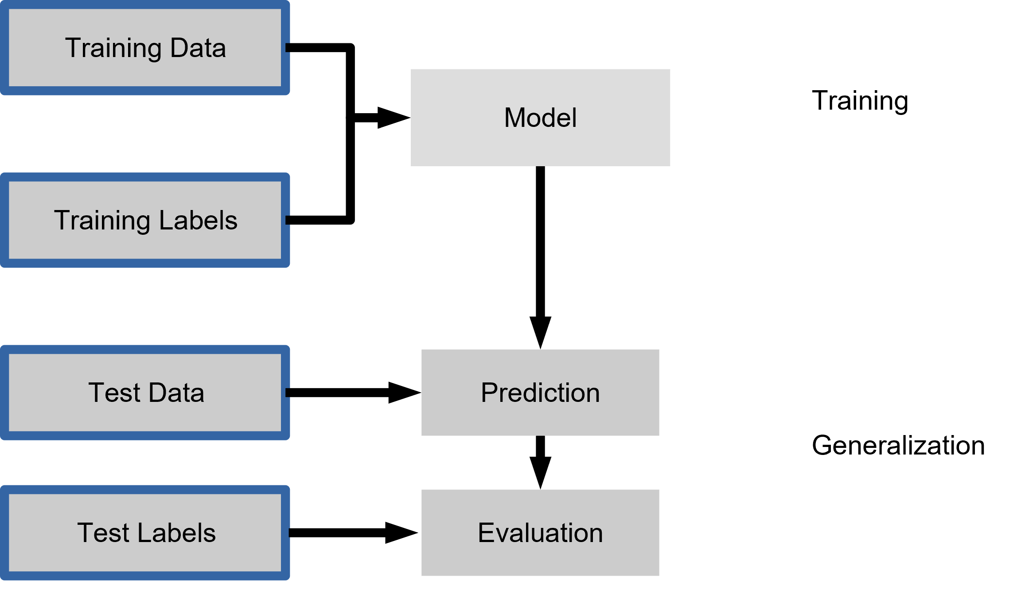
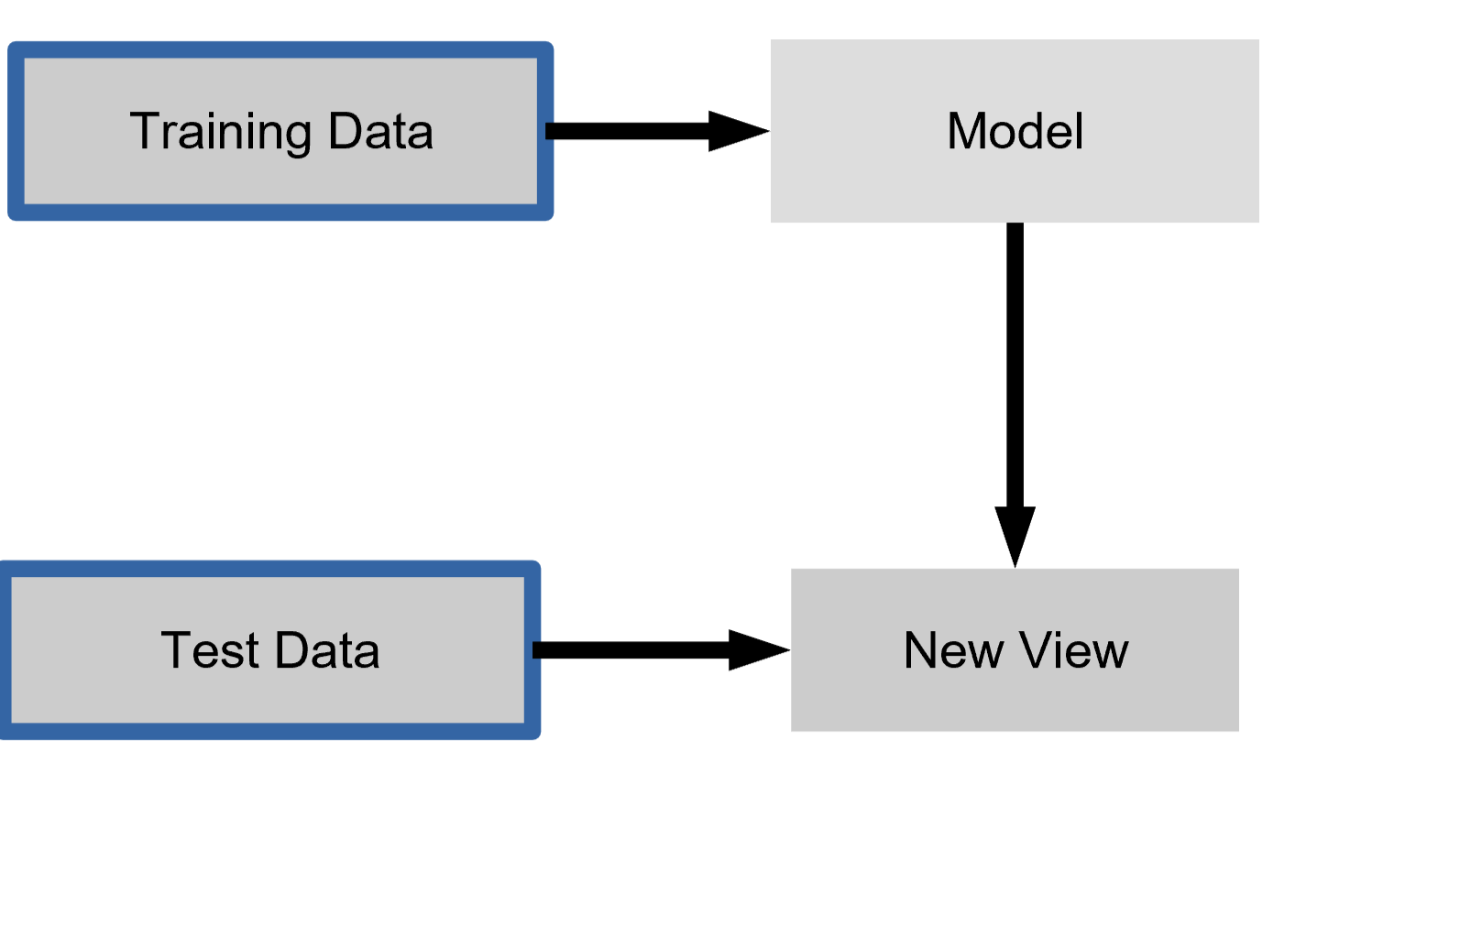
Supervised/Unsupervised Learning

Slide 8
Supervised Learning

Slide 9
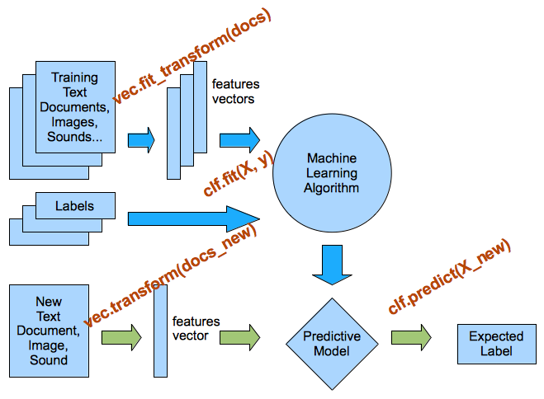
Supervised Learning

Slide 10
Unsupervised Learning

Slide 11
Basic Algorithm
K NN
K Means
Naïve Bayes
Decision Tree
Gradient Boosting algorithms
SVM
Random Forest
Linear Regression
Logistic Regression
Dimensionality Reduction Algorithms

Slide 12
How do you choose a machine learning algorithm
?

Slide 13


Slide 14
Something Funny In Security
鱼叉式网络钓鱼
生成相似的密码进行攻击
Webshell, XSS,DGA,Malware(since 1994),Tojan检测
病毒检测绕过,生成病毒
去马赛克
生成相似人脸,手写签名
聊天机器人
………

Slide 15
Input
Output
Data PreProcessing
Feature Engineering

Slide 16
With Python Or R
Python and Pythonic
ML library
Common library

Slide 17
With Python Or R
Python and Pythonic
ML library
Common library
Don’t fighting language, Pythonic

Slide 18
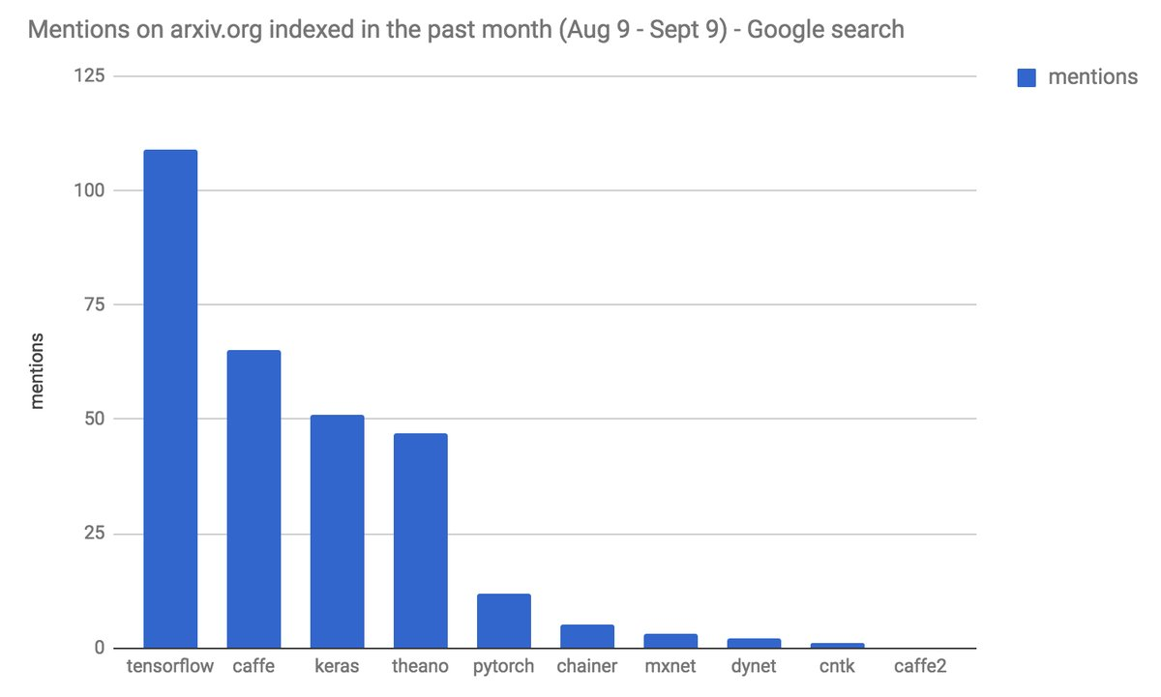
With Python Or R
Python and Pythonic
ML library
Common library
Tensorflow
Keras
Scikit-Learn
Pytorch

Slide 19
With Python Or R
Python and Pythonic
ML library
Common library
Pandas
Numpy
Scipy
Matplotlib
Pyplot
Ndarray
Scikit-image
Image

Slide 20
R: I forget it ...
Easily And Powerful

Slide 21
Examples:
MNIST
DGA/XSS/Webshell

Slide 22
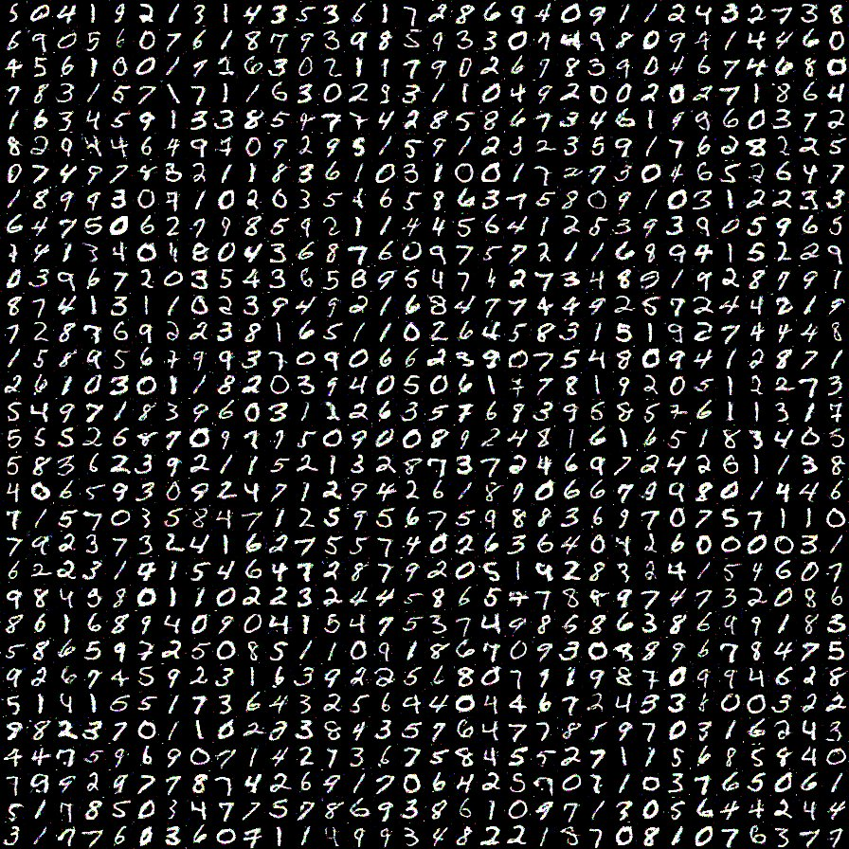
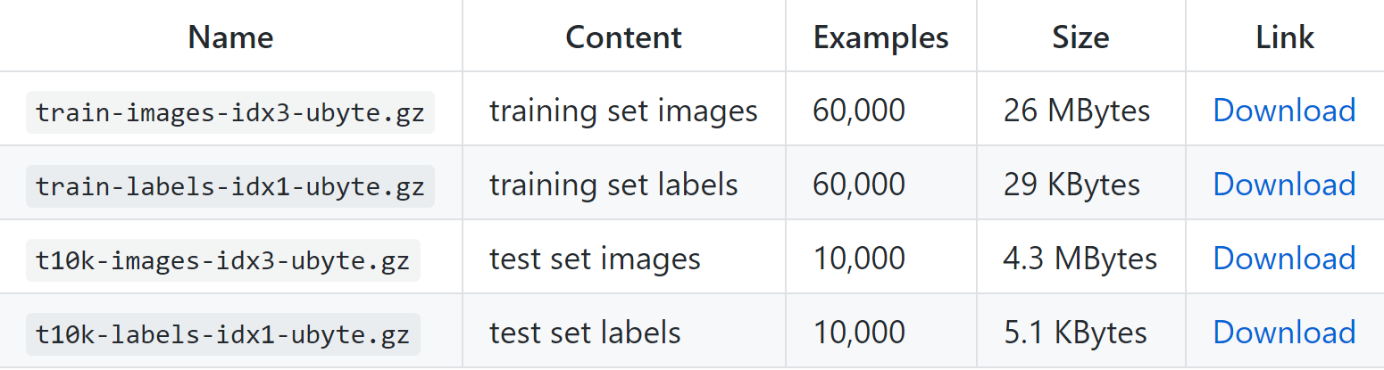
MNIST
DGA/XSS/Webshell

Slide 23
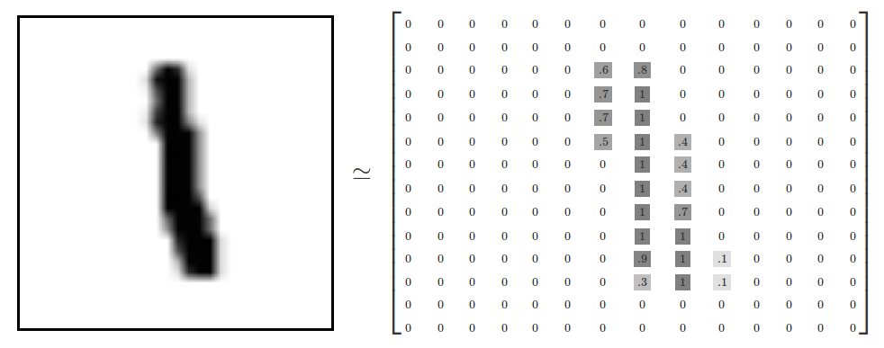
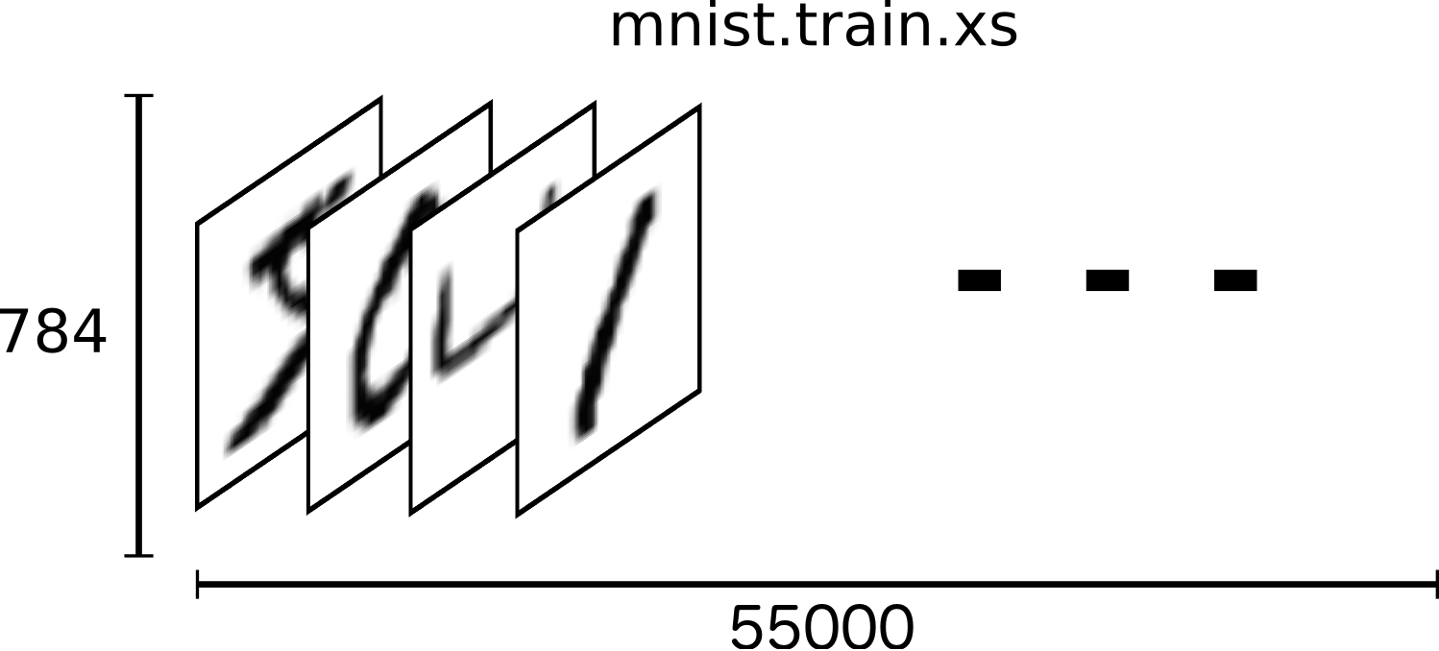
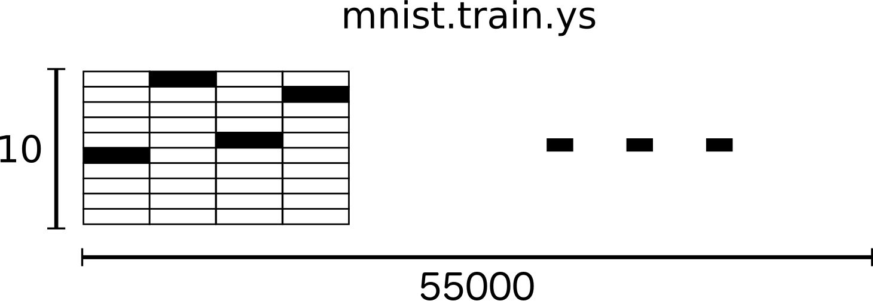
Mnist And Fashion-Mnist
Pro
Beginners
Online Demo

Slide 24
Algorithm 1 : KNN

Slide 25
Principle
Wikipedia

Slide 26
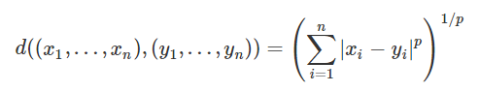
Principle

Slide 27
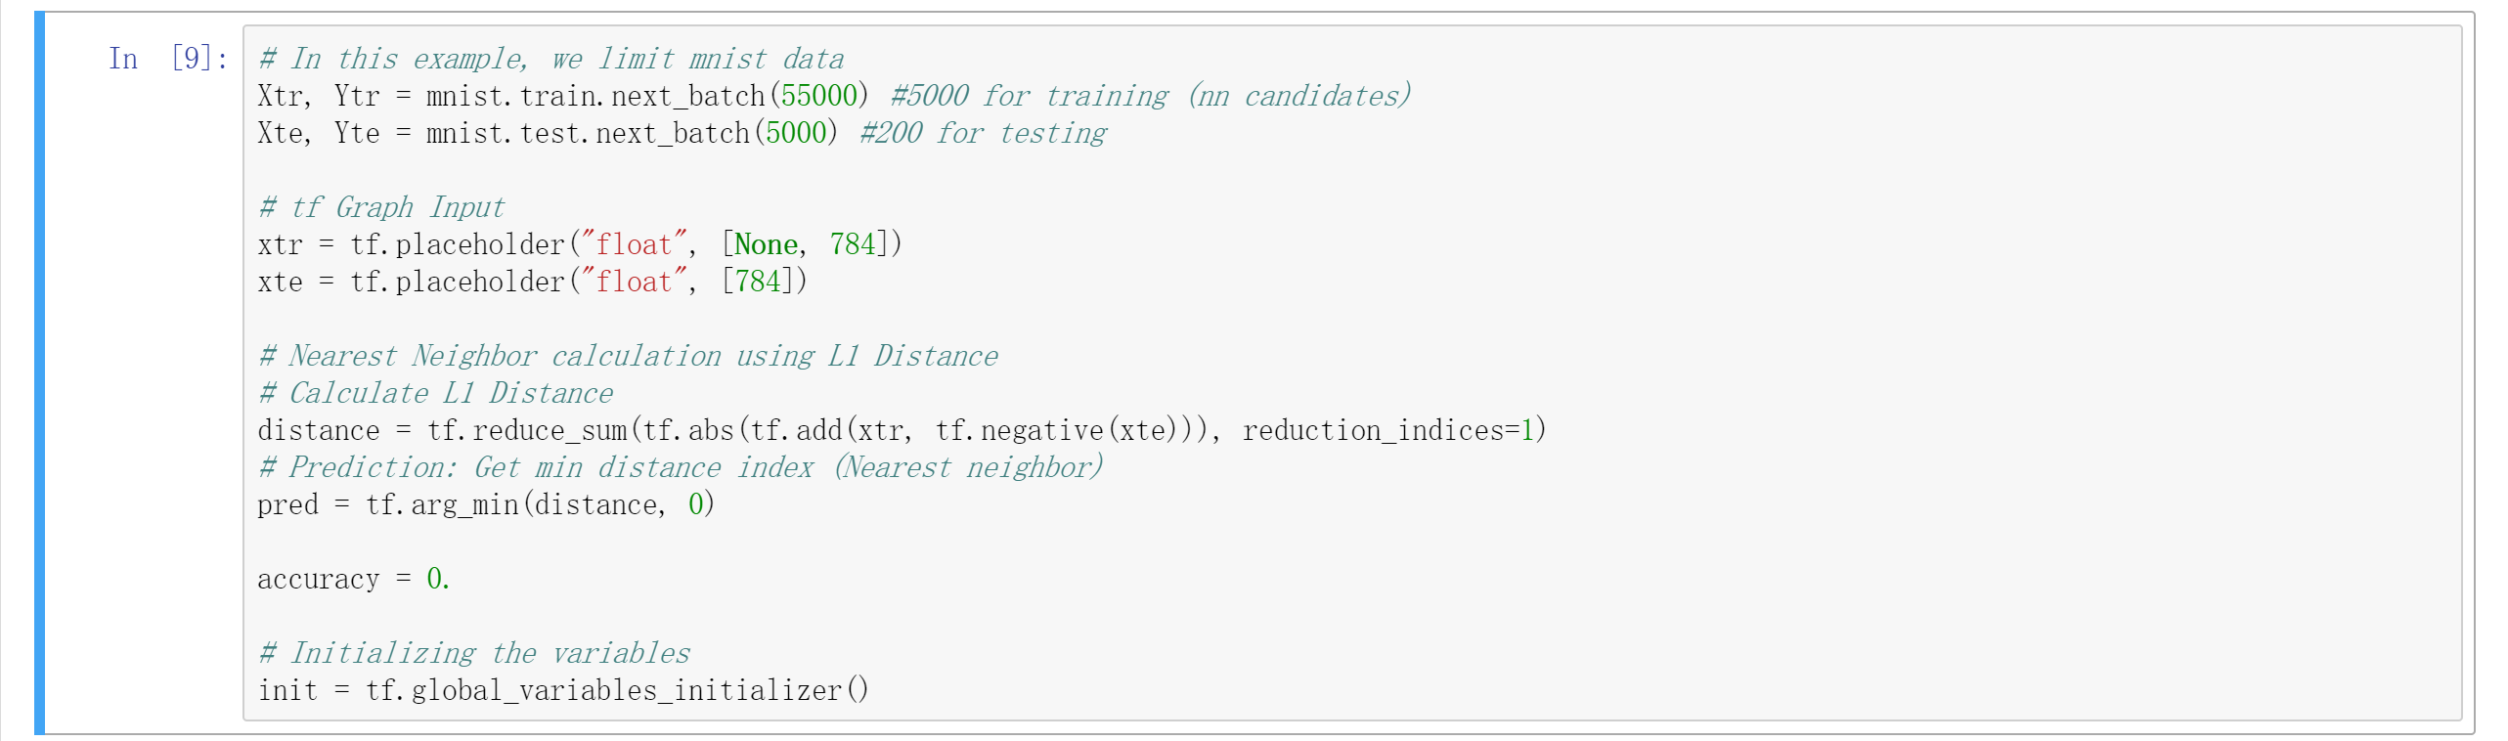
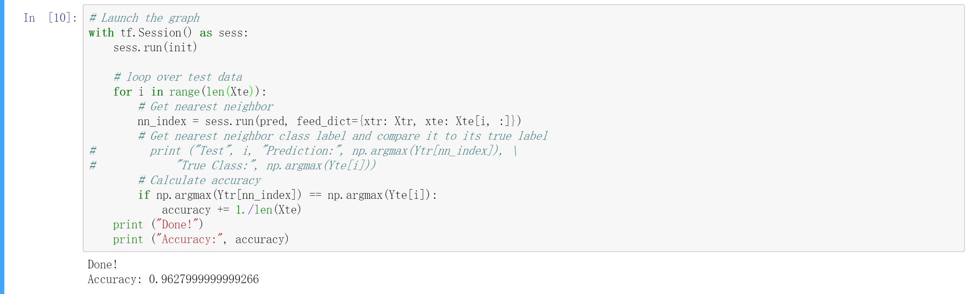
Code in Python

Slide 28
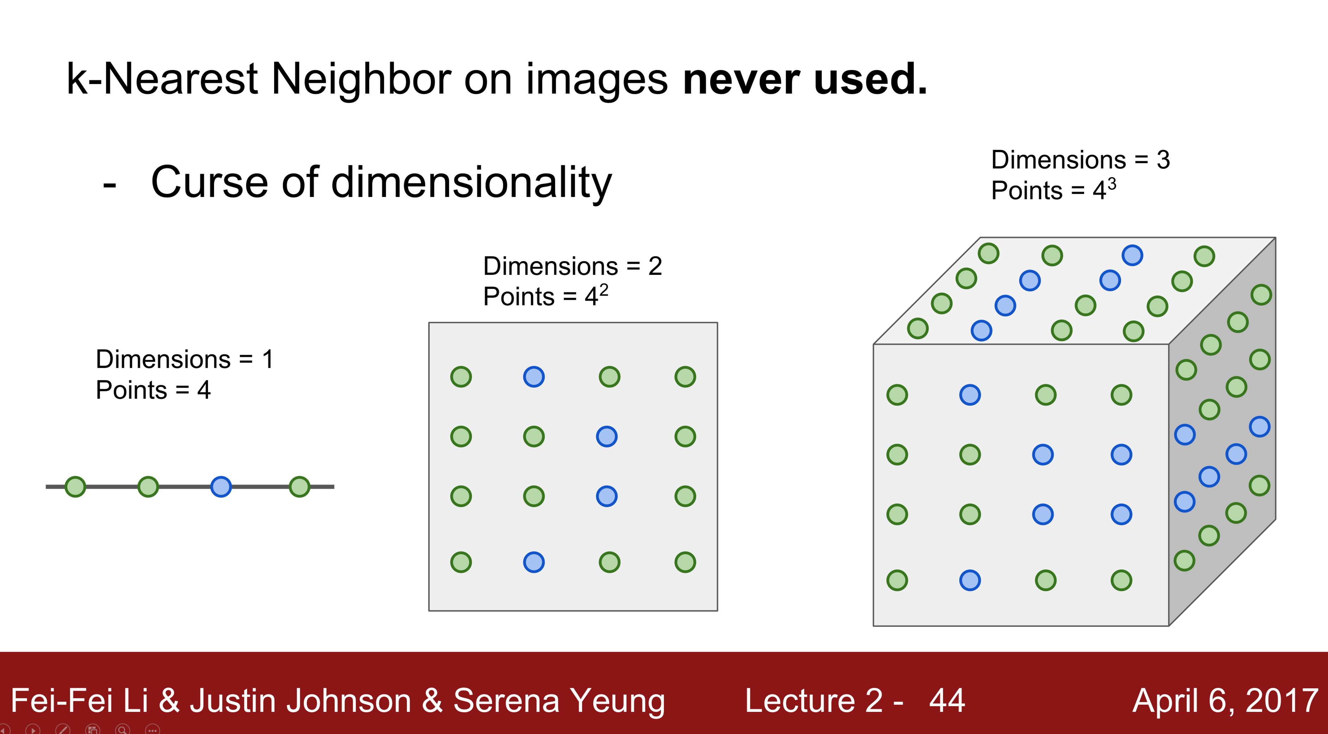

Slide 29
Algorithm 2 : SVM

Slide 30
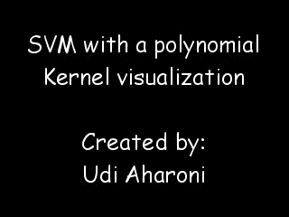
Principle

Slide 31
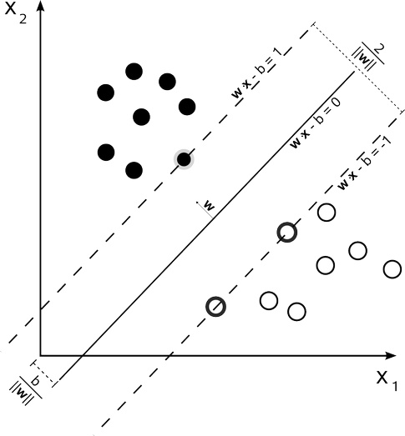
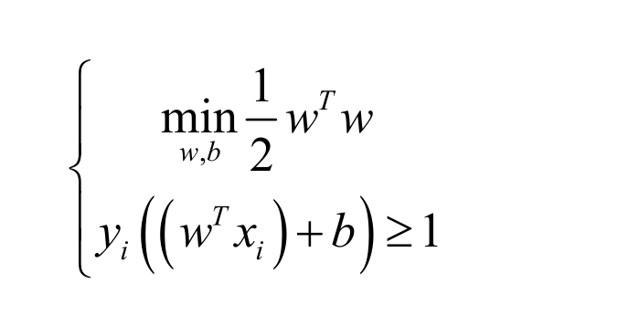
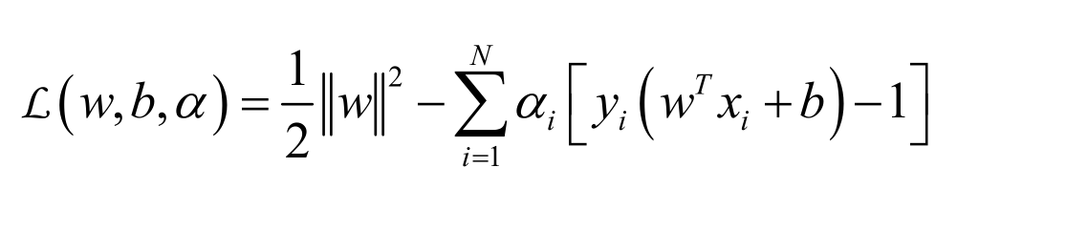
Principle
推理论证可来此处看看http://www.cnblogs.com/jerrylead/archive/2011/03/18/1988419.html

Slide 32
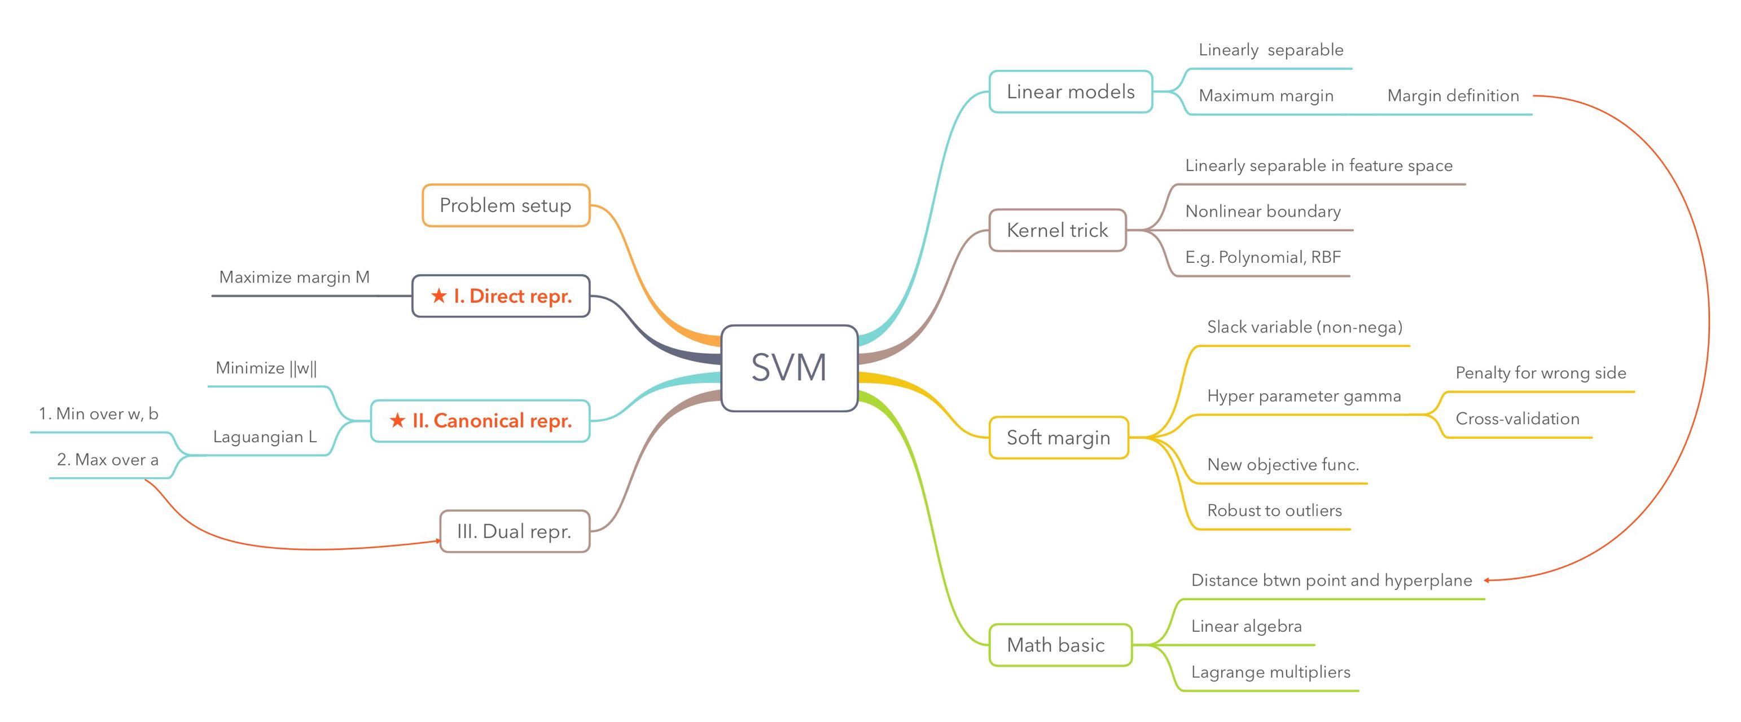
https://www.zhihu.com/question/21094489

Slide 33
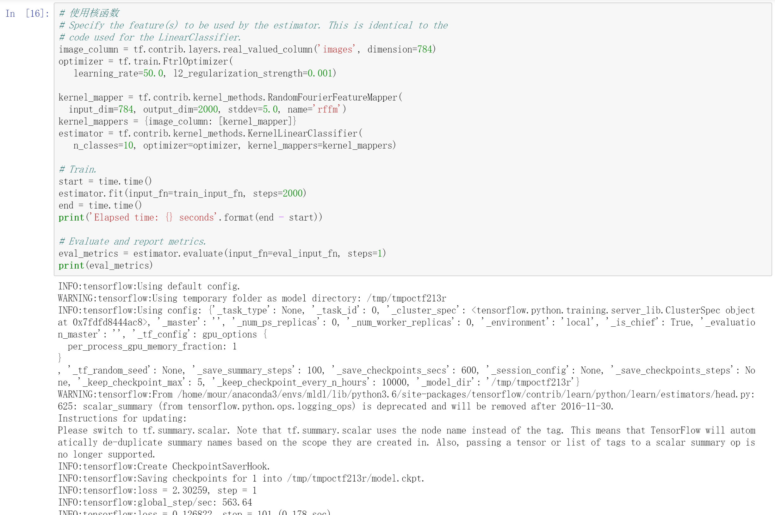
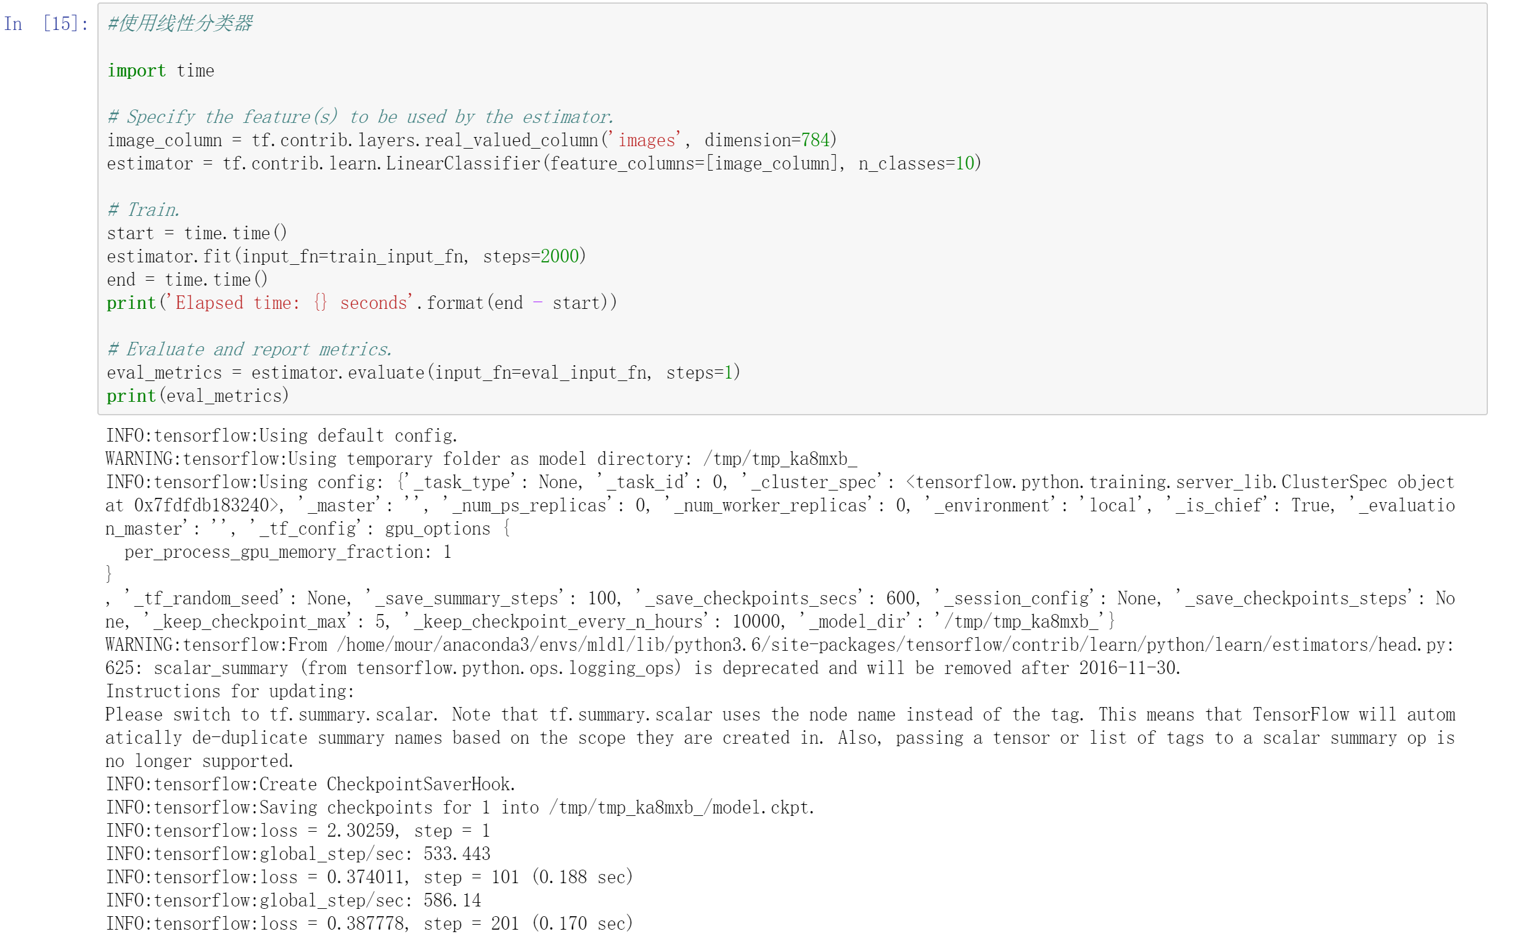
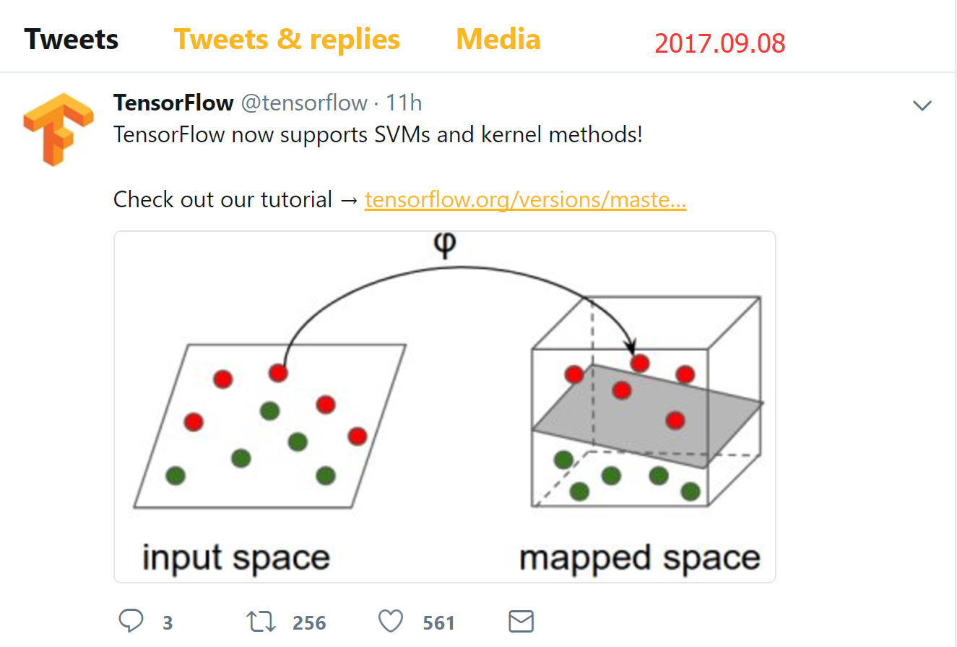
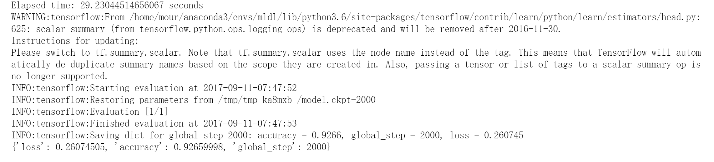
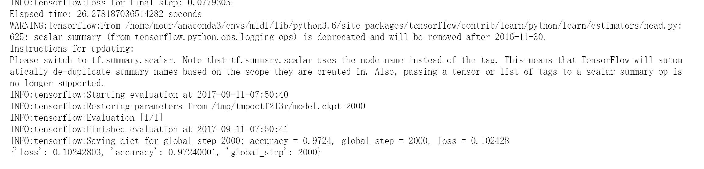
Code in Python
With Tensorflow

Slide 34
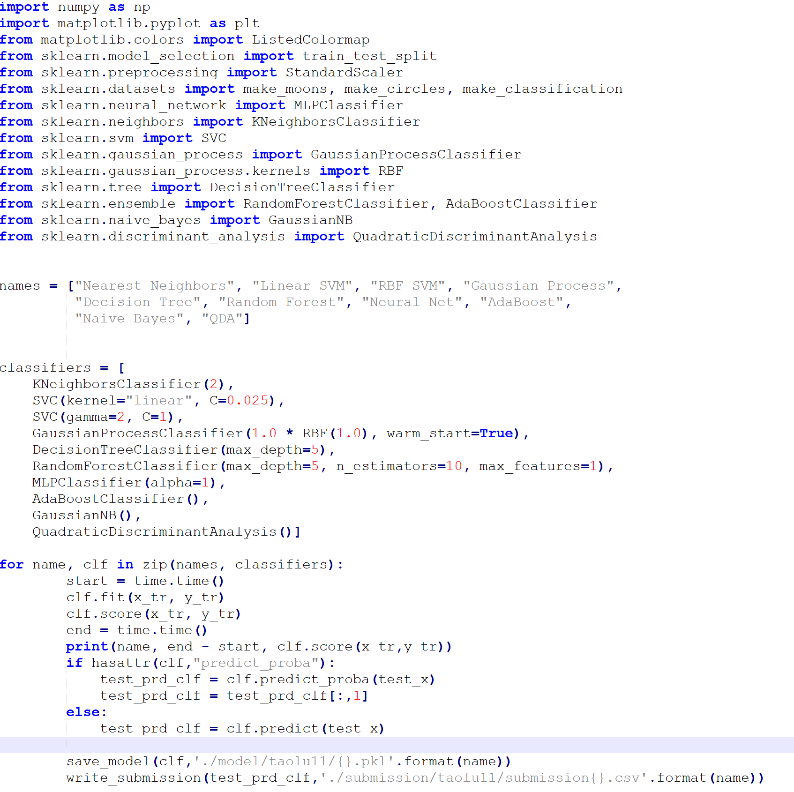
Benchmark with Scikit-Learn

Slide 35
这种常规算法一般来讲没必要使用Tensorflow.TF类的框架都是为神经网络(NN)准备的。
CNN,RNN, LSTM, MLP,GAN等等

Slide 36
假装此处放置了一个各种算法在MNIST上的精确度列表

Slide 37
Other: Apply with Fashion-Mnist ?

Slide 38
MNIST
DGA/XSS/Webshell
Domain Generation Algorithm
Cross Site Scripting
Webshell

Slide 39
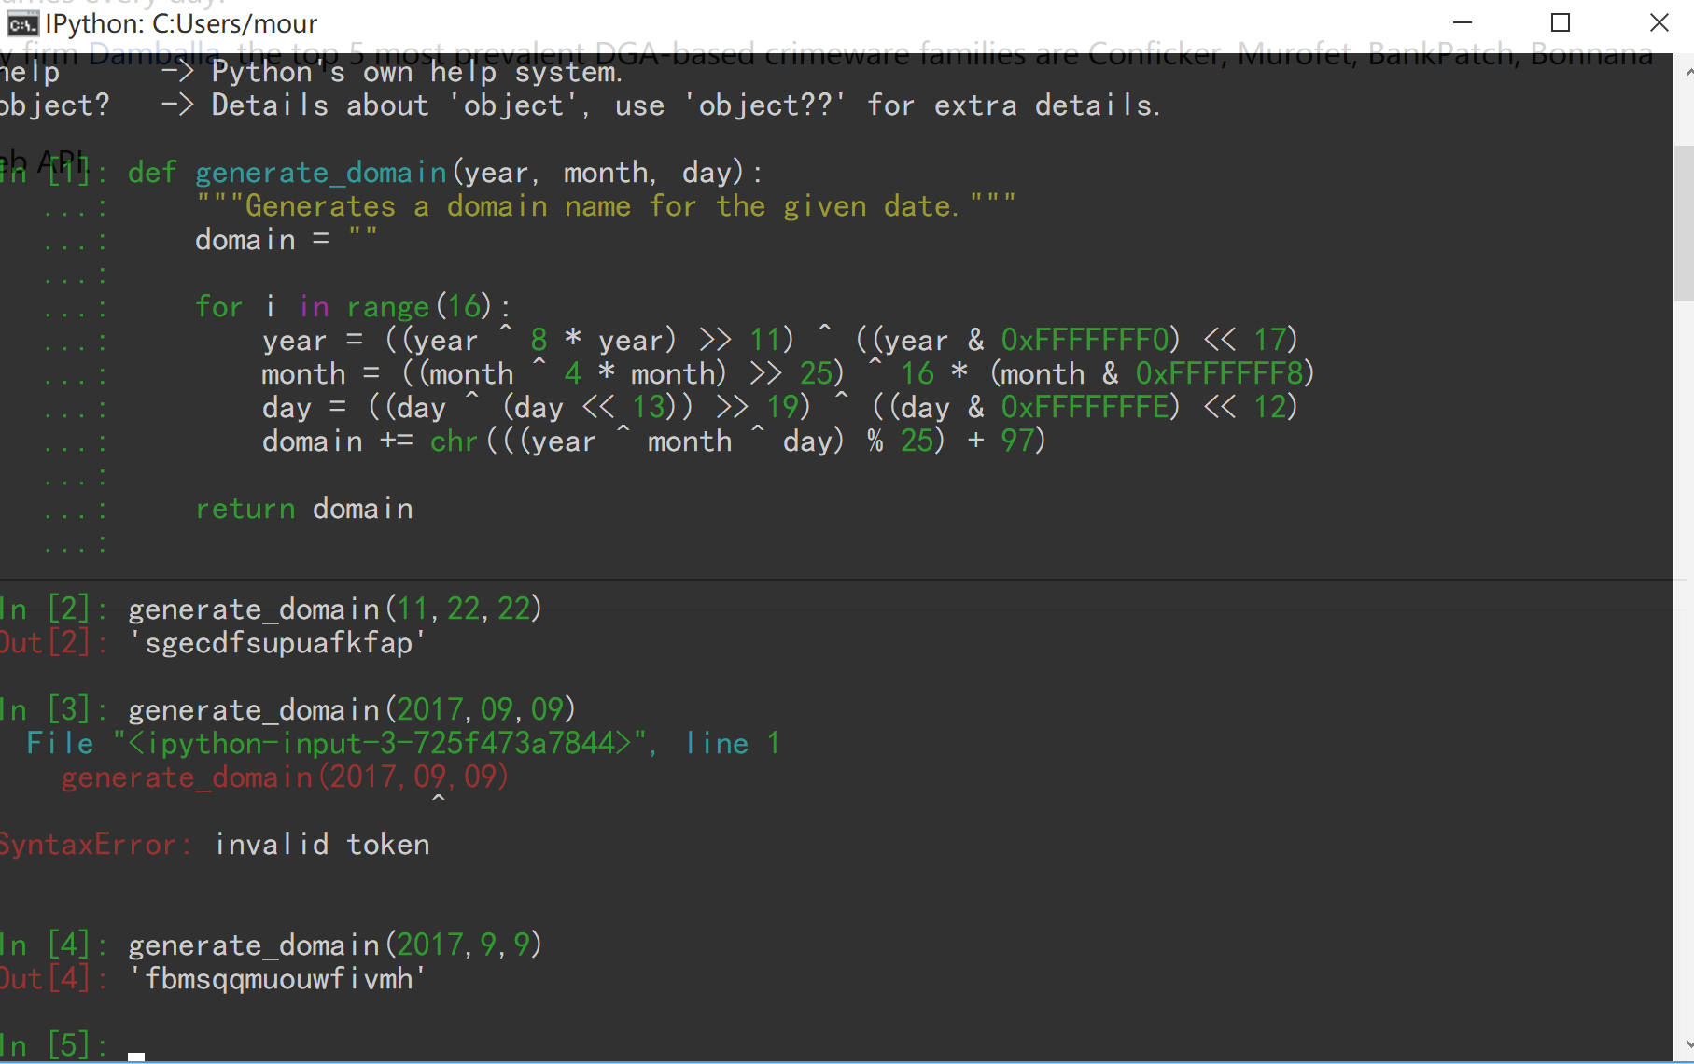
MNIST
DGA/XSS/Webshell

Slide 40
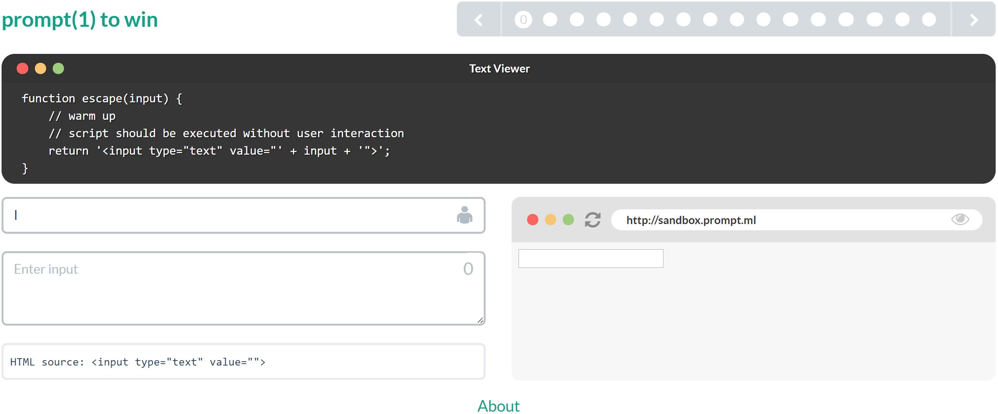
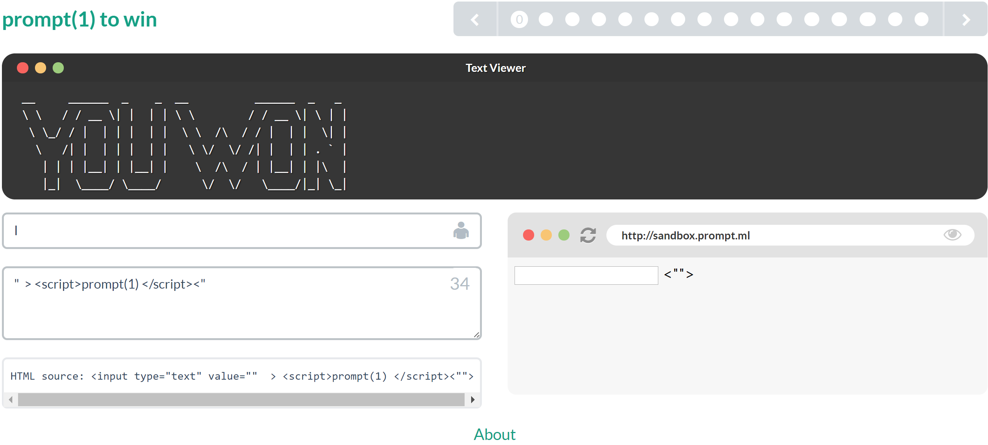
MNIST
DGA/XSS/Webshell
http://prompt.ml/0

Slide 41
Reflected (non-persistent)
Persistent
Server-side versus DOM-based vulnerabilities
Other
MNIST
DGA/XSS/Webshell

Slide 42
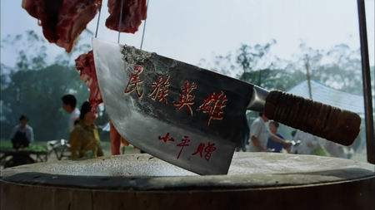
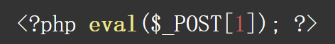
MNIST
DGA/XSS/Webshell

Slide 43
安全小飞侠的批量上传单个Webshell
MNIST
DGA/XSS/Webshell
AntSword
CaiDao/菜刀

Slide 44
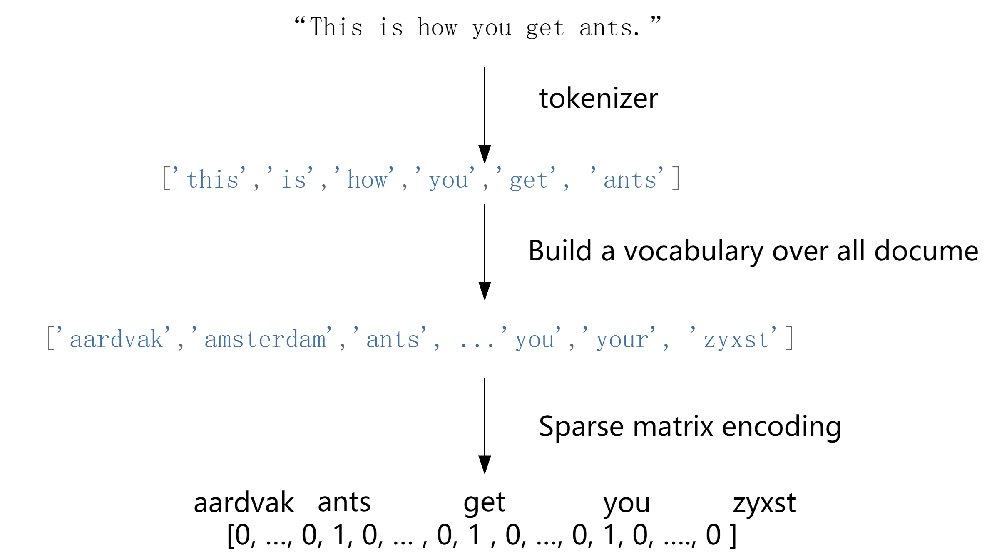
MNIST
DGA/XSS/Webshell
Natura language processing

Slide 45
Algorithm 3 : Naïve Bayes

Slide 46
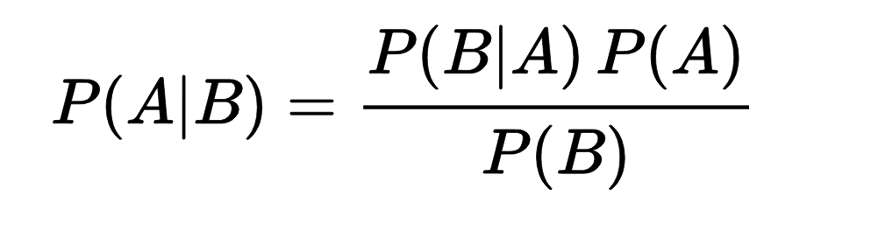
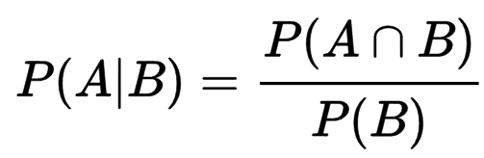
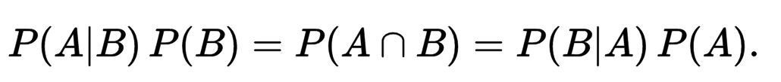
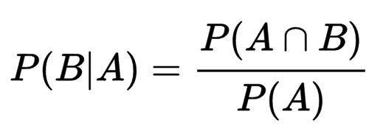
Principle

Slide 47
Principle
https://monkeylearn.com/blog/practical-explanation-naive-bayes-classifier/
https://www.analyticsvidhya.com/blog/2015/09/naive-bayes-explained/
https://stackoverflow.com/questions/10059594/a-simple-explanation-of-naive-bayes-classification#20556654

Slide 48
Scipy-2017-sklearn
http://172.16.10.222:8889/notebooks/12.Case_Study-SMS_Spam_Detection.ipynb

Slide 49
Other: DGA Top 1 million url

Slide 50
Art is Long, Life is short

Slide 51

初学机器学习易陷入一个误区: 以为机器学习是若干种算法(方法)的堆积, 熟练了“十大算法”或“二十大算法”一切即可迎刃而解, 于是将目光仅聚焦在具体算法推导和编程实现上; 待到实践发现效果不如人意, 则又转对机器学习发生怀疑. 须知, 书本上仅能展示有限的典型“套路”,而现实世界任务千变万化, 以有限之套路应对无限之变化, 焉有不败！现实中更多时候, 需依据任务特点对现有套路进行改造融通. 算法是“死”的, 思想才是“活”的. 欲行此道, 则务须把握算法背后的思想脉络, 无论创新科研还是应用实践, 皆以此为登堂入室之始. 本书在有限篇幅中侧重于斯, 冀望辅助读者奠造进一步精进的视野心法. 读者由本书初入门径后, 不妨搁书熟习“套路”, 数月后再阅, 于原不经意处或能有新得. 此外, 作者在一些角落融入了自己多年研究实践的些微心得, 虽仅只言片语, 但可能不易得之, 进阶读者阅之或可莞尔.
---- 周志华《机器学习》

Slide 52
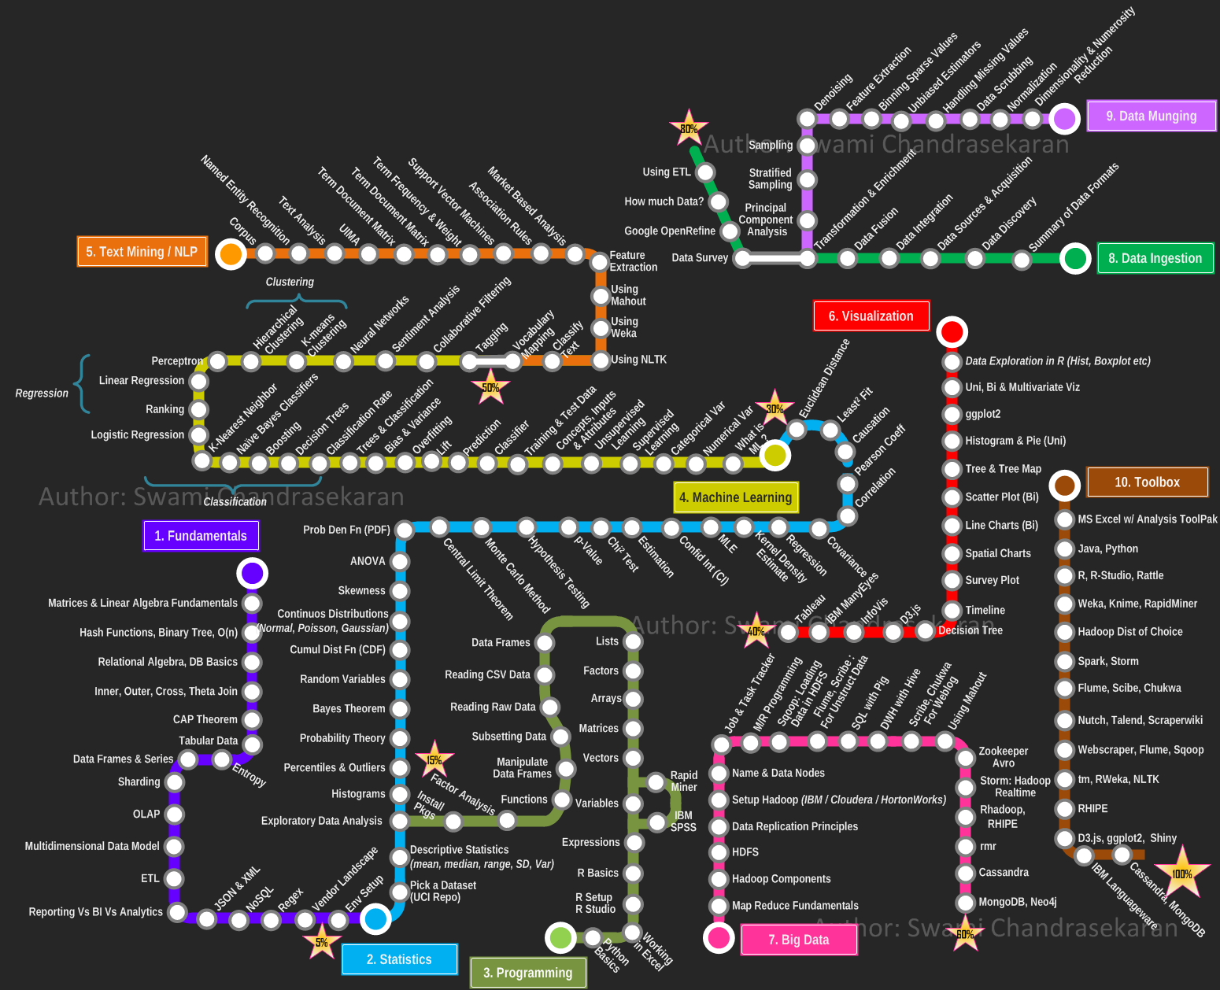
RoadMap

Slide 53
Welcome to Machine Learning

Slide 54
关于技术分享
提前做好准备，不仅是分享者还是参与者
本着自由的精神，如无兴趣，可随时离开
Focus
方法论在前，但是也不要只分享思想性的东西，只有经过了实践才能领悟到正确的方法。没有实践,全是空谈。分享之前，自己实践过吗？
技术分享面向的是研发，所以听的懂很好，听不懂更好，可以自己去学。不要老是兼顾,兼顾到最后失去了分享的意义,变成了打发时间的扯淡。
要想技术有提高,总要是从不懂到懂得。
每次分享后的知识应得到实践和对实践结果的反馈

Slide 55
关于技术分享
Why？
1.例如上上次关于Dos, 其实bcrypt加密算法只接受8-58长度，所以不可能产生DOS。
2.上次代码重构的分享中提到了避免继承，但设计模式中的开闭原则(OCP)则提倡通过继承，多态等方法避免对原有程序的改动。

Slide 56
Thanks
Design by mour
Since 09.07

